Slide 1
Computational Thermal Engineering
Numerical methods – Stability analysis
DAY 4
Kumaresh Selvakumar

Slide 2
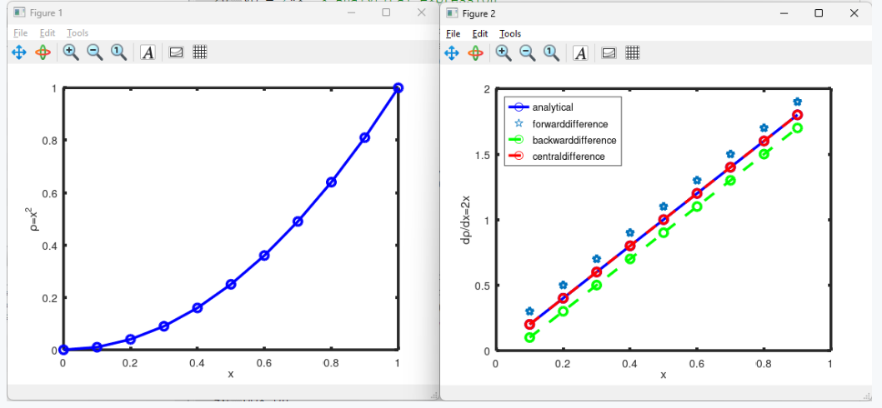
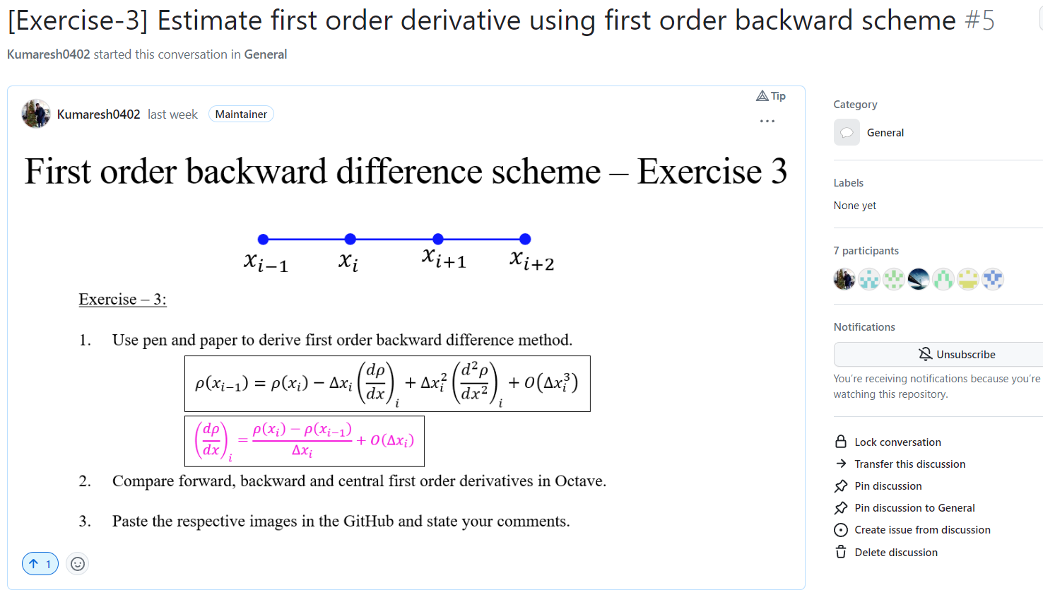
Quick Recap

Slide 3
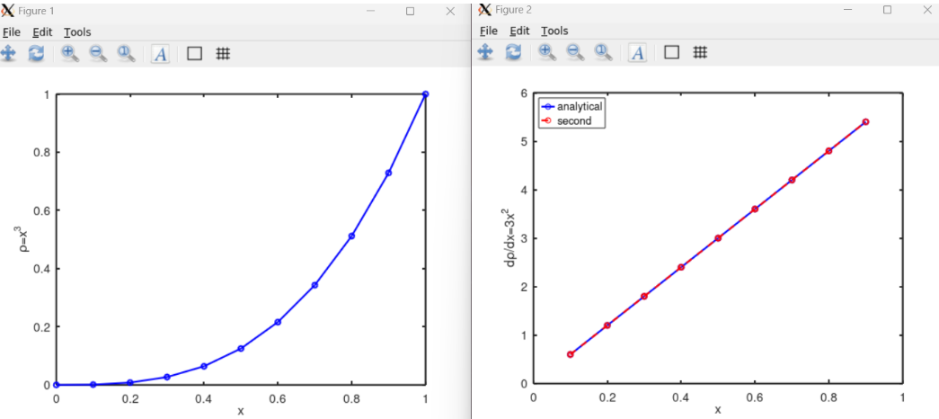
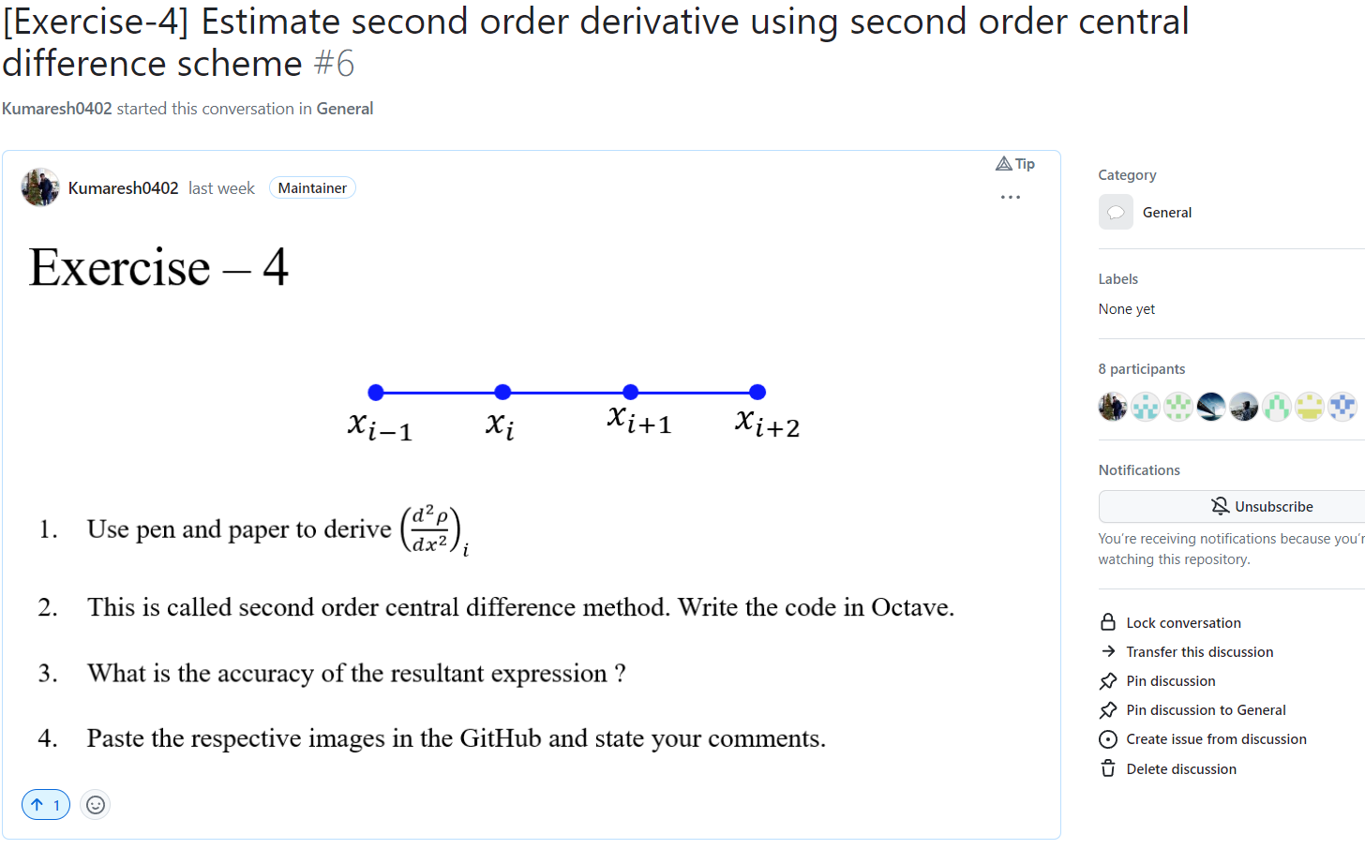
Quick Recap

Slide 4
Contents
Numerical stability
Advection equation
Exercise – 5 (i) and (ii)
Install VS code
Clone the working directory from GitHub
Introduction to C++ for OpenFOAM

Slide 5
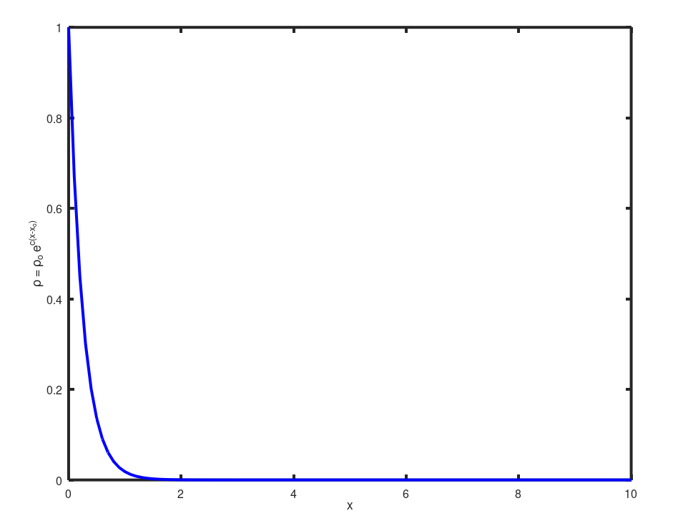
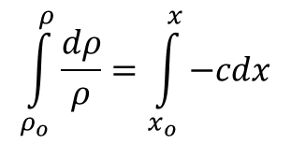
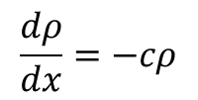
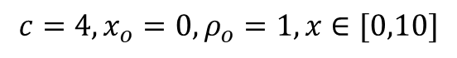
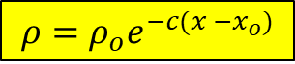
Numerical Stability
Numerical approach should not magnify the error that appears in the solution.
$$\frac{dρ}{dx}=−cρ$$
$$\int_{ρ_{o}}^{ρ}{\frac{dρ}{ρ}}=\int_{x_{o}}^{x}{−cdx}$$
Analytical
$$ρ=ρ_{o}e^{−c(x −x_{o})}$$
$$c=4, x_{o}=0, ρ_{o}=1, x∈[0,10]$$

Slide 6
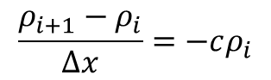
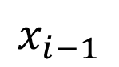
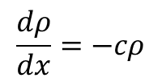
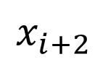
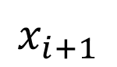
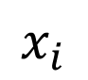
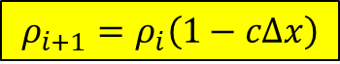
Numerical Stability
Numerical discretization
$$\frac{dρ}{dx}=−cρ$$
$$x_{i−1}$$
$$x_{i}$$
$$x_{i+1}$$
$$x_{i+2}$$
$$\frac{ρ_{i+1}−ρ_{i}}{Δx}=−cρ_{i}$$
Numerical
$$ρ_{i+1}=ρ_{i}\left(1−cΔx\right)$$

Slide 7
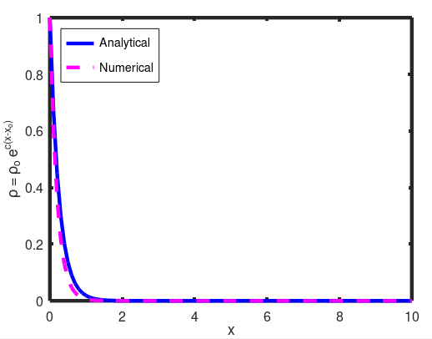
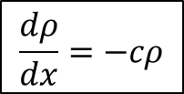
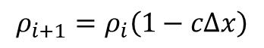
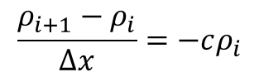
Numerical Stability
Numerical discretization
$$x_{i−1}$$
$$x_{i}$$
$$x_{i+1}$$
$$x_{i+2}$$
$$\frac{dρ}{dx}=−cρ$$
$$\frac{ρ_{i+1}−ρ_{i}}{Δx}=−cρ_{i}$$
$$ρ_{i+1}=ρ_{i}\left(1−cΔx\right)$$
$$c=4, x_{o}=0, ρ_{o}=1, x∈\left[0,10\right], Δx=0.1$$

Slide 8
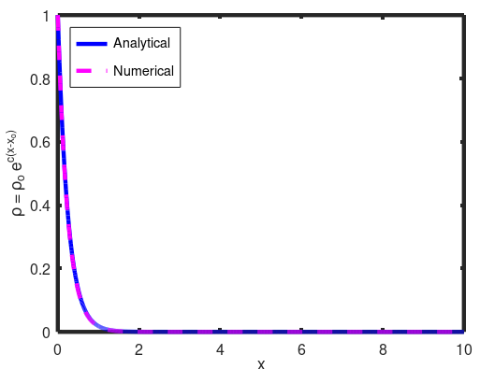
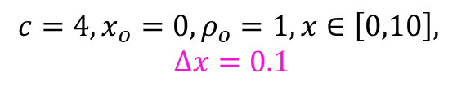
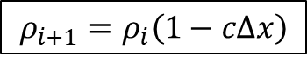
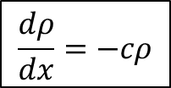
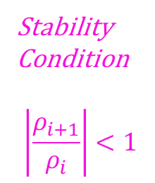
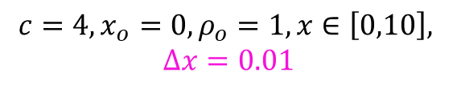
Numerical Stability
$$x_{i−1}$$
$$x_{i}$$
$$x_{i+1}$$
$$x_{i+2}$$
$$\frac{dρ}{dx}=−cρ$$
$$ρ_{i+1}=ρ_{i}\left(1−cΔx\right)$$
Stability
Condition
$$\left|\frac{ρ_{i+1}}{ρ_{i}}\right|<1$$
$$c=4, x_{o}=0, ρ_{o}=1, x∈\left[0,10\right],$$
$$Δx=0.1$$
$$c=4, x_{o}=0, ρ_{o}=1, x∈\left[0,10\right],$$
$$Δx=0.01$$

Slide 9
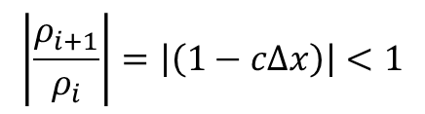
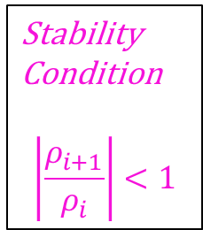
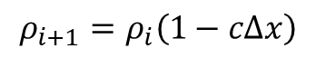
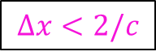
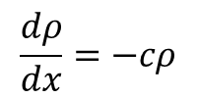
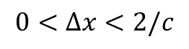
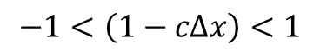
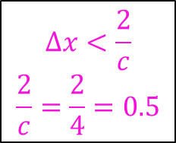
Numerical Stability
Stability
Condition
$$\left|\frac{ρ_{i+1}}{ρ_{i}}\right|<1$$
$$\frac{dρ}{dx}=−cρ$$
$$x_{i−1}$$
$$x_{i}$$
$$x_{i+1}$$
$$x_{i+2}$$
$$ρ_{i+1}=ρ_{i}\left(1−cΔx\right)$$
$$\left|\frac{ρ_{i+1}}{ρ_{i}}\right|=\left|\left(1−cΔx\right)\right|<1$$
$$−1<\left(1−cΔx\right)<1$$
$$0<Δx<2/c$$
$$Δx<\frac{2}{c}$$
$$\frac{2}{c}=\frac{2}{4}=0.5$$
$$Δx<2/c$$

Slide 10
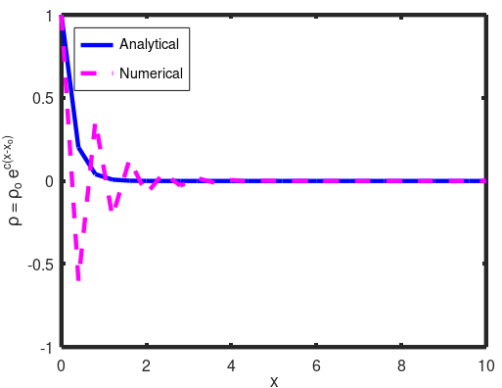
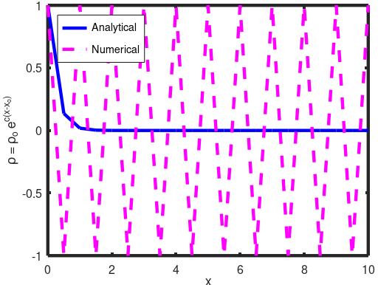
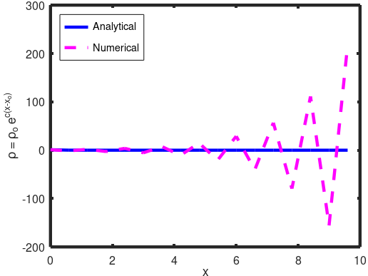
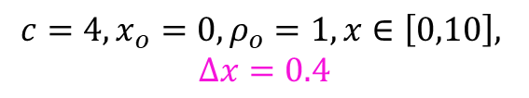
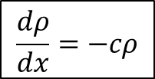
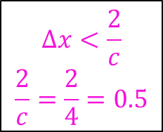
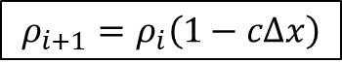
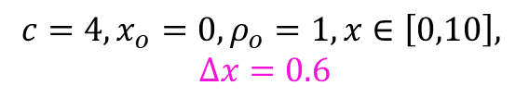
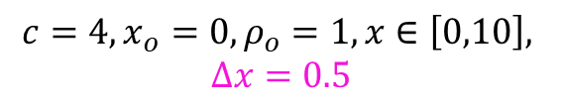
Numerical Stability
$$Δx<\frac{2}{c}$$
$$\frac{2}{c}=\frac{2}{4}=0.5$$
$$x_{i−1}$$
$$x_{i}$$
$$x_{i+1}$$
$$x_{i+2}$$
$$\frac{dρ}{dx}=−cρ$$
$$ρ_{i+1}=ρ_{i}\left(1−cΔx\right)$$
$$c=4, x_{o}=0, ρ_{o}=1, x∈\left[0,10\right],$$
$$Δx=0.4$$
$$c=4, x_{o}=0, ρ_{o}=1, x∈\left[0,10\right],$$
$$Δx=0.5$$
$$c=4, x_{o}=0, ρ_{o}=1, x∈\left[0,10\right],$$
$$Δx=0.6$$

Slide 12
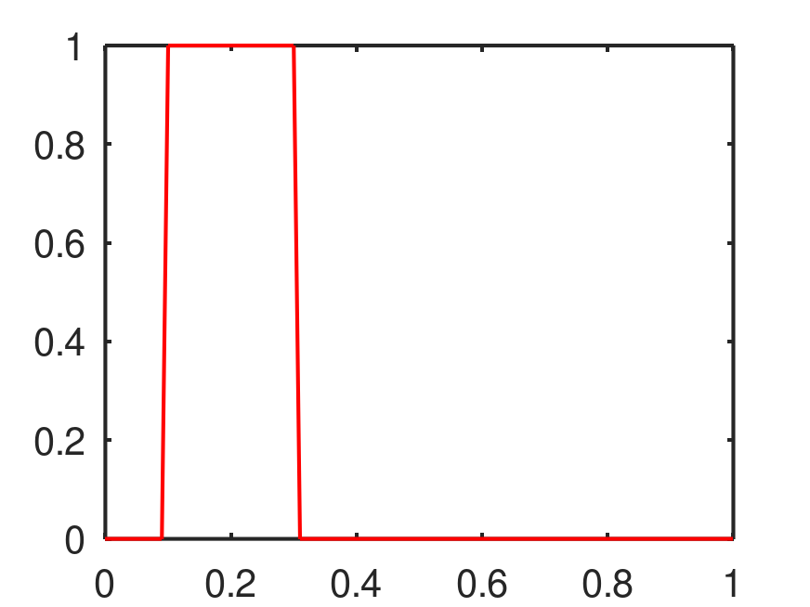
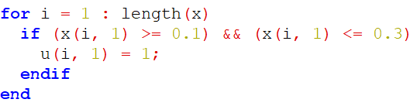
Numerical Stability - Advection equation

Slide 13
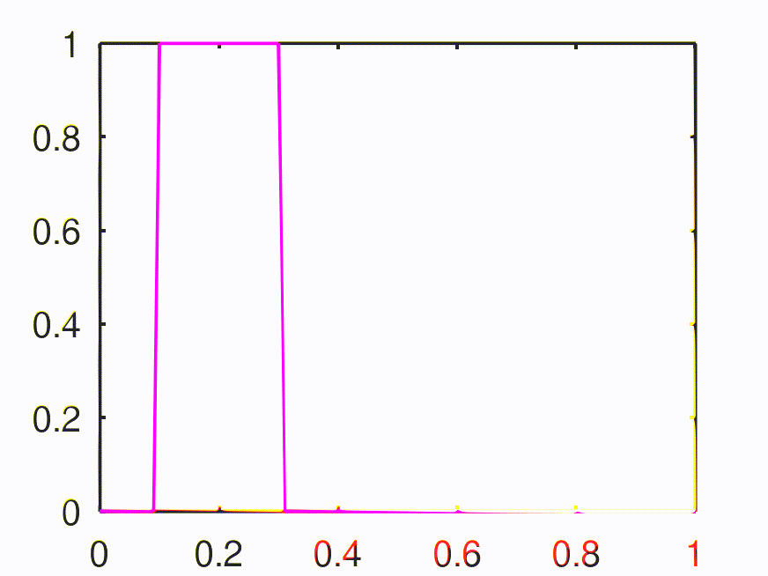
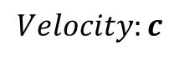
Numerical Stability - Advection equation
$$Velocity:c$$

Slide 14
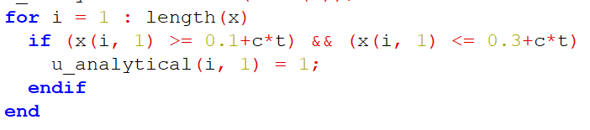
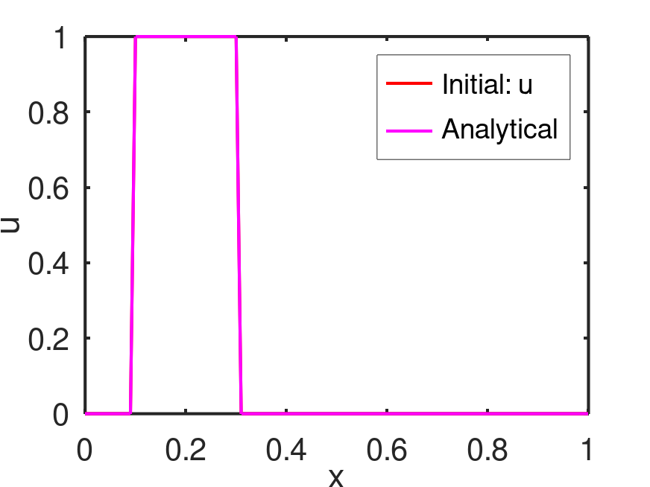
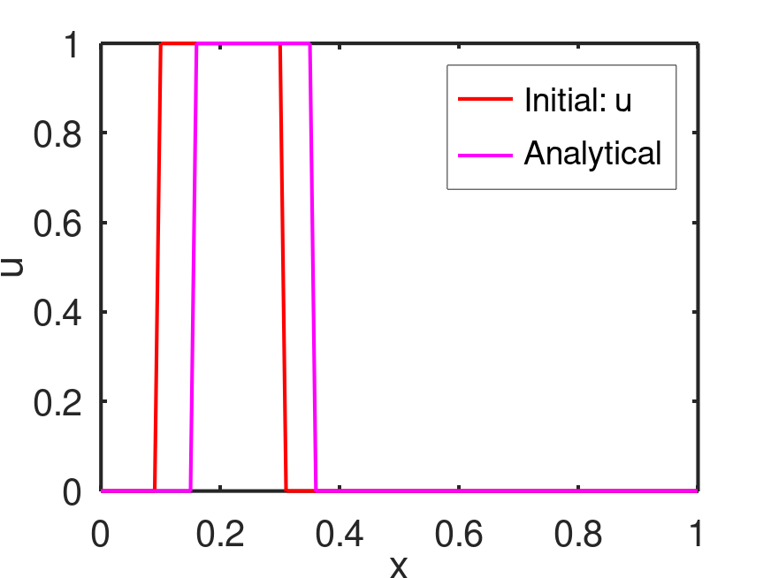


Numerical Stability - Advection equation
$$\frac{∂u}{∂t}+c\frac{∂u}{∂x}=0$$
Advection equation

Slide 15

Numerical Stability - Advection equation

Slide 16

Exercise – 5 (i)
$$x_{i−1}$$
$$x_{i}$$
$$x_{i+1}$$
$$x_{i+2}$$
Solve the following advection equation analytically in octave
Upload in GitHub
$$\frac{∂u}{∂t}+c\frac{∂u}{∂x}=0$$

Slide 17






Numerical Stability - Advection equation
$$\frac{∂u}{∂t}+c\frac{∂u}{∂x}=0$$
$$\frac{u_{i}^{n+1}−u_{i}^{n}}{Δt}+c{\left(\frac{∂u}{∂x}\right)}_{i}^{n}=0$$
$$x_{i−1}$$
$$x_{i}$$
$$x_{i+1}$$
$$x_{i+2}$$
$${\left(\frac{∂u}{∂x}\right)}_{i}^{n}≈\frac{u_{i+1}^{n}−u_{i}^{n}}{Δx_{i}}$$
Simple forward
difference scheme
$$u_{i}^{n+1}=u_{i}^{n}−cΔt{\left(\frac{∂u}{∂x}\right)}_{i}^{n}$$
$${\left(\frac{∂u}{∂x}\right)}_{i}^{n}≈\frac{u_{i+1}^{n}−u_{i−1}^{n}}{2Δx_{i}}$$
Central difference
(Explicit) First order - Forward Euler
(only one unknown (n+1) with other knowns at n^{th} node

Slide 18










Numerical Stability - Advection equation
Time level: $n+1$
$$x_{i−1}$$
$$x_{i}$$
$$x_{i+1}$$
$$x_{i+2}$$
Time level: $n$
$$x_{i+1}$$
$$x_{i+2}$$
$$x_{i−1}$$
$$x_{i}$$
Information from right to left end
$${\left(\frac{∂u}{∂x}\right)}_{i}^{n}≈\frac{u_{i+1}^{n}−u_{i}^{n}}{Δx_{i}}$$
Simple forward
difference scheme
$$u_{i}^{n+1}=u_{i}^{n}−cΔt{\left(\frac{∂u}{∂x}\right)}_{i}^{n}$$
$${\left(\frac{∂u}{∂x}\right)}_{i}^{n}≈\frac{u_{i+1}^{n}−u_{i−1}^{n}}{2Δx_{i}}$$
Central difference
Notes:
Consider example of u_i = 1, u_{i+1}=0 and give numerical demo to obtain u_i^{n+1}.
Consider example of u_i=0, u_{i+1}=1

Slide 19




Application: Differential equation used in physics, weather forecasting, stoke markets behaviors (based on probability, past and present information and predicting future information)
Numerical Stability - Advection equation
Time level: $n+1$
$$x_{i−1}$$
$$x_{i}$$
$$x_{i+1}$$
$$x_{i+2}$$
Time level: $n$
$$x_{i+1}$$
$$x_{i+2}$$
$$x_{i−1}$$
$$x_{i}$$
Information from left and right ends
$${\left(\frac{∂u}{∂x}\right)}_{i}^{n}≈\frac{u_{i+1}^{n}−u_{i}^{n}}{Δx_{i}}$$
Simple forward
difference scheme
$$u_{i}^{n+1}=u_{i}^{n}−cΔt{\left(\frac{∂u}{∂x}\right)}_{i}^{n}$$
$${\left(\frac{∂u}{∂x}\right)}_{i}^{n}≈\frac{u_{i+1}^{n}−u_{i−1}^{n}}{2Δx_{i}}$$
Central difference
Notes:
Consider example of u_i = 1, u_{i+1}=0, u_{i-1}=1 and give numerical demo to obtain u_i^{n+1}.
Consider example of u_i = 0, u_{i+1}=1, u_{i-1}=0 and give numerical demo to obtain u_i^{n+1}.

Slide 20




Numerical Stability - Advection equation
Time level: $n+1$
$$x_{i−1}$$
$$x_{i}$$
$$x_{i+1}$$
$$x_{i+2}$$
Time level: $n$
$$x_{i+1}$$
$$x_{i+2}$$
$$x_{i−1}$$
$$x_{i}$$
Information from left to right end
Wind is flowing from left end (bird moves from left to right)
$$u_{i}^{n+1}=u_{i}^{n}−cΔt{\left(\frac{∂u}{∂x}\right)}_{i}^{n}$$
$${\left(\frac{∂u}{∂x}\right)}_{i}^{n}≈\frac{u_{i}^{n}−u_{i−1}^{n}}{Δx_{i}}$$
Simple backward
difference scheme
Notes:
Consider example of u_i = 1, u_{i+1}=0, u_{i-1}=1 and give numerical demo to obtain u_i^{n+1}.
Consider example of u_i=0, u_{i+1}=0, u_{i-1}=1
Mention this scheme depends on the sign of “c”

Slide 21







Numerical Stability - Advection equation
$$\frac{∂u}{∂t}+c\frac{∂u}{∂x}=0$$
$$u_{i}^{n+1}=u_{i}^{n}−cΔt{\left(\frac{∂u}{∂x}\right)}_{i}^{n}$$
$${\left(\frac{∂u}{∂x}\right)}_{i}^{n}≈\frac{u_{i}^{n}−u_{i−1}^{n}}{Δx_{i}}$$
Simple backward
difference scheme
Upwind scheme
(Point 1)
(Point 2)
(Point 3)
(Point 4)
Information from left to right end
Wind is flowing from left end (Flowing with the wind)
$$u_{i}^{n+1}=u_{i}^{n}−cΔt{\left(\frac{∂u}{∂x}\right)}_{i}^{n}$$
$${\left(\frac{∂u}{∂x}\right)}_{i}^{n}≈\frac{u_{i+1}^{n}−u_{i}^{n}}{Δx_{i}}$$
Simple forward
difference scheme
$$CFL: \frac{cΔt}{Δx}$$
CFL = 0.1
Courant - Friedrichs - Lewy Number
Downwind scheme
Wind is flowing from right end (Flowing against the wind)
Notes:
High CFL

Slide 22







Numerical Stability - Advection equation
$$u_{i}^{n+1}=u_{i}^{n}−cΔt{\left(\frac{∂u}{∂x}\right)}_{i}^{n}$$
$${\left(\frac{∂u}{∂x}\right)}_{i}^{n}≈\frac{u_{i}^{n}−u_{i−1}^{n}}{Δx_{i}}$$
Simple backward
difference scheme
Upwind scheme
$$CFL: \frac{cΔt}{Δx}$$
CFL = 1.5
$$Δt$$
increase
Notes:
High CFL

Slide 23




What did we discuss ?
Proper discrete approximations need to be chosen based on the velocity field.
CFL number is critical to ensure numerical stability.
Upwind scheme
$$u_{i}^{n+1}=u_{i}^{n}−cΔt{\left(\frac{∂u}{∂x}\right)}_{i}^{n}$$
$${\left(\frac{∂u}{∂x}\right)}_{i}^{n}≈\frac{u_{i}^{n}−u_{i−1}^{n}}{Δx_{i}}$$
Simple backward
difference scheme
Downwind scheme
$$u_{i}^{n+1}=u_{i}^{n}−cΔt{\left(\frac{∂u}{∂x}\right)}_{i}^{n}$$
$${\left(\frac{∂u}{∂x}\right)}_{i}^{n}≈\frac{u_{i+1}^{n}−u_{i}^{n}}{Δx_{i}}$$
Simple forward
difference scheme

Slide 24

Exercise – 5 (ii)
$$x_{i−1}$$
$$x_{i}$$
$$x_{i+1}$$
$$x_{i+2}$$
Solve the following advection equation numerically in octave
Central difference with CFL = 0.1 (dx = 0.01, c = 0.01, dt = 0.1, t_final = 5)
Upwind scheme (backward difference) with CFL = 0.1 (dx = 0.01, dt = 0.1, t_final = 5). Change the ”c” value between 0.01 and -0.01 and analyze the stability.
Downwind scheme (forward difference) with CFL = 0.1 (dx = 0.01, dt = 0.1, t_final = 5). Change the ”c” value between 0.01 and -0.01 and analyze the stability.
Examine CFL numbers. Analyse the upwind scheme with CFL = 0.1, 1.0, and 10. Analyze the stability.
Upload in GitHub.
$$\frac{∂u}{∂t}+c\frac{∂u}{∂x}=0$$
Notes:
CFL < 1 – Numerically stable (conditionally stable based on the condition imposed by CFL)
CFL > = 1 – Numerically unstable

Slide 25


Install VS code

Slide 26

Install VS code
Write this command in your terminal window

Slide 27




Clone the directory
(1) Create a new directory named “workspace”
(3) If you got the above error, type the following commands in the terminal as follows:
ssh-keygen -t rsa -b 4096
<enter-enter-enter>
cat ~/.ssh/id_rsa.pub
Then copy the entire result from the command (cat ~/.ssh/id_rsa.pub) and paste here by creating New SSH key.
(2) Copy SSH key

Slide 28

After cloned, working directory from GitHub appears

Slide 29


Run VS code

Slide 30


Install C++ packages

Slide 31



Introduction to C++ for OpenFOAM
Type the command
Output file “sample” appeared.

